Slide 1

Driver drowsiness detection and alarm system
APS COLLEGE OF ENGINEERING
Prajval P 1ap17ec033
Skandesh Suresh 1ap17ec040
Yekshith Bushan N 1ap17ec047
PROJECT GUIDE:
Ms. USHA H N
Assistant Professor
Dept. of ECE
HOD:
Dr. JAGADEESH H S
Dept. of ECE

Slide 2
Contents
Abstract
About the Project
Introduction
Literature Survey
System Architecture
Hardware and Software Requirements
Proposed Method
Working
Eye Aspect Ratio
Mouth Aspect Ratio
Sensors
Applications
Advantages
Disadvantages
Future scope
Conclusion
Result
References

Slide 3
Abstract
The modern technology has developed well and has brought about advancements in driving systems. Yet the number of road accidents in India and worldwide have not dropped significantly. The major reasons for the same are drowsiness and fatigue. Hence the driver drowsiness and fatigue detection are a major area which could be improved to prevent a large number of sleep induced road accidents. The system would employ various parameters such as blink-rate, eye closure, and yawning into consideration to effectively identify the drowsiness of the driver in real time, and also the physical condition of the vehicle taking many factors into consideration such as temperature, weather and the gaseous temperament of the vehicle . With the proposed methods and with the help of the additional sensors installed, we hope to contribute in reducing the number of road accidents using simple methodologies and approaches.
Notes:
We hope to develop a Real Time Drowsiness Detection System to install in motor vehicles with the help of conventional Computer Vision applications.

Slide 4
About the project
Automotive population is increasing exponentially in our country. The Biggest problem regarding the increased use of vehicles is the rising number of road accidents. Road accidents are undoubtedly a global menace in our country. The frequency of road accidents in India is among the highest in the world. According to the reports of the National Crime Records Bureau (NCRB) about 4,37,396 road accidents were recorded across India in 2019, resulting in the death of 154732 people. The Global Status Report on Road Safety published by the World Health Organization (WHO) identified the major causes of road accidents are due to errors and carelessness of the driver.
The major driver errors are caused by drowsiness, drunken and reckless behavior of the driver. The resulted errors and mistakes contribute much loss to humanity. In order to minimize the effects of driver abnormalities, a system for abnormality monitoring must be inbuilt with the vehicle.

Slide 5
introduction
Drowsiness Detection and Alarm System will be developed using non-intrusive machine vision-based concepts. In such a case when fatigue is detected, a warning signal is issued to alert the driver. The system deals with using information obtained for the binary (monochrome) version of the image to find the edges of the face, which narrows down the area of where the eyes may exist. Considering the knowledge that the eye regions and the mouth region in the face show pattern changes, the eyes and mouth are located by finding the significant pattern changes in the face.
The sensors will be an additional feature to this concept where it will help determine the external factors of the vehicle like the temperature, weather outside, and if any harmful gases emitted by the engine is causing the driver’s drowsiness.
Notes:
We hope to test the proposed method to detect fatigue after carefully observing and analyzing the driver’s face eyes and mouth.
There are multiple ways to detect eyes and mouth in a video. This is relatively a new problem, so the standard technique has not been established. Eye blinks and yawns can be detected by referencing significant facial landmarks. Many software libraries can plot significant facial features within a given region of interest.
Python’s dlib library uses Kazemi and Sullivan’s One Millisecond Face Allignment with an Ensemble of Regression Trees to implement this feature.

Slide 6
LITERATURE SURVEY
Serial No. | Title of Journal | Author(s) | Publisher | Summary | Drawbacks
[1] | Driver Drowsiness Detection System | Athira Gopal, V Vineeth | Independent publication | Driver Drowsiness Detection System is developed using non-intrusive machine vision based concepts. The system uses a small monochrome camera that points directly towards the driver’s face and monitors the driver’s eyes in order to detect fatigue. In case fatigue is detected, a warning signal is issued to alert the driver. This report describes how to find the eyes, and also how to determine if the eyes are opened or closed. | The system relies solely on the state of the eyes, i.e., whether the eyes are opened or closed, and sets a threshold to the duration which the eyes can be closed. It doesn’t make use of other governing factors like facial features, etc.

Slide 7
Serial No. | Title of Journal | Author(s) | Publisher | Summary | Drawbacks
[2] | Driver Fatigue Detection Based on Eye Tracking | Mandalapu Sarada Devi, Dr. Preeti R Bajaj | IEEE Computer Society | A system is designed that uses video camera that points directly towards the driver’s face in order to detect fatigue. If fatigue is detected, a warning signal is issued to alert the driver. Video files recorded by the camera are extracted. They is converted into frames. Once the eyes are located from each frame, by measuring the distances between the intensity changes in the eye area one can determine whether the eyes are open or closed. The system draws the conclusion that the driver is falling asleep and issues a warning signal, based on the number of frames the eyes are found closed. | This system is highly dependent on analysing the intensity changes in the eye region in order to detect fatigue of the driver.

Slide 8
Serial No. | Title of Journal | Author(s) | Publisher | Summary | Drawbacks
[3] | Drowsiness Detection of a Driver using Conventional Computer Vision Articles | Hitendra Garg | IEEE Xplore | A system which uses pre-existing facial landmark detection to identify the sate of drowsiness and fatigue. 68-facial landmarks helps in shape prediction to clearly identify the various regions of the face. Each extracted frame is analyzed and to study facial features to determine the EAR and MAR for each frame. EAR and MAR values when exceed their respective threshold values for a certain amount of consecutive frames an alert will be sent to the driver. | The work is based on behavioural analysis, high end camera installation and conventional algorithm to detect the possible coordinates.

Slide 9
Serial No. | Title of Journal | Author(s) | Publisher | Summary | Drawbacks
[4] [5] | Vehicle speed sensing and smoke detecting system. Development of Sensor and Optimal Placement for Smoke Detection in an Electric Vehicle Battery Pack | Prashanna Rangan (Kongu Engineering College) Mukund Kulkarni, Saravanan Meenatchi Sundaram, Vinten Diwakar | Research-gate publications IEEE Computer Society | For the project the drowsiness of the driver can cause due to external factors also. Such factors include Carbon Monoxide gas leakage from the engine or CNG gas from some particular vehicles. Using the MQ9 sensor we can detect such gages and alert the driver to prevent any causalities. In this project we plan to implement a sensor inside the dashboard to log the temperature and alert if the temperatures inside the car cross a certain temperature limit. This signals can be sent using the sensor module hence alerting the driver. | The sensor may occasionally fail and hence faulty signals could be sent to the microcontroller board. The sensor may fail due to weather conditions, and may sense false data signals which could be faulty causing a mis read.

Slide 10
LITERATURE SURVEY
Serial No. | Title of Journal | Author(s) | Publisher | Summary | Drawbacks
[6] | Obstacle Avoidance with Ultrasonic Sensors | Johann Borenstein, Yoram Koren | IEEE Computer Society | Using the ultrasonic sensors we can calculate the distance between the car and any obstacle. If the obstacle is very close to the car crossing the set limit this will indicate the driver of the obstacle and hence alerting to stop the movement of the car. | The sensor may malfunction, it may show inaccurate data due to dust particles in the sensor.

Slide 11
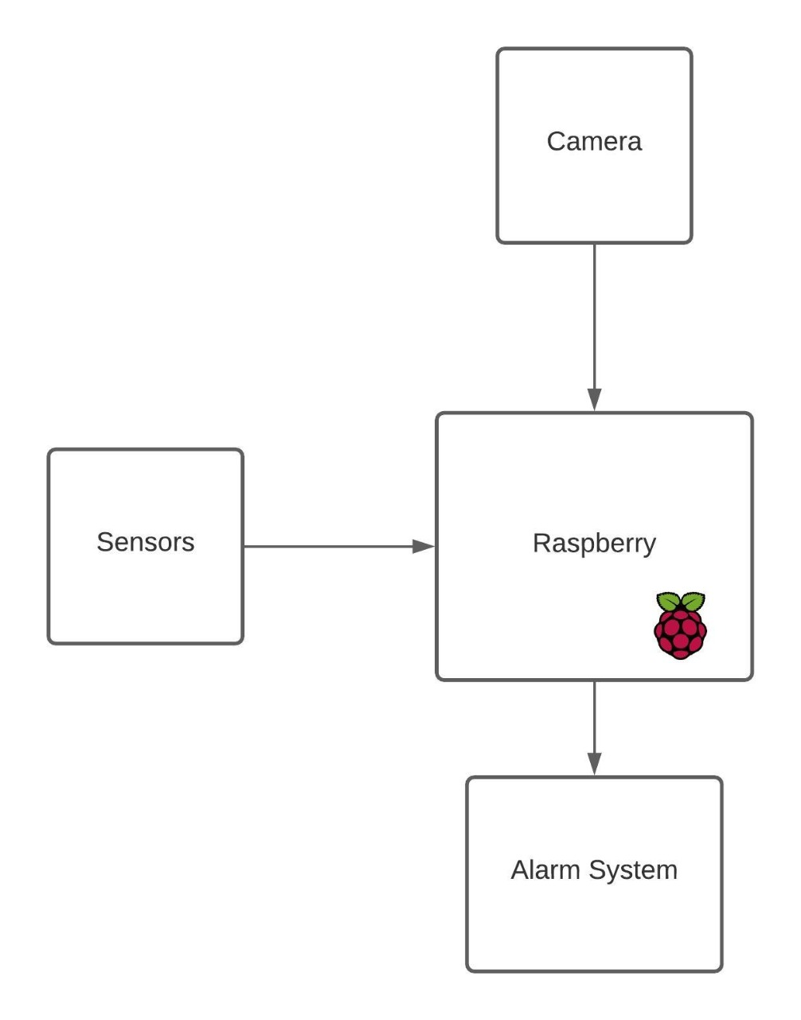
System Architecture
Figure 1: System Architecture

Slide 12
Hardware and software Requirements
Hardware Requirements
Raspberry Pi 3 Model B
Digital Camera as a recording device
Buzzer
Arduino Uno
Sensors
MQ9 Gas Sensor
DHT-11 Sensor
HC_SR04 Sensor
Software Requirements
Python Programming Language
Raspberry Pi OS or Ubuntu Desktop
Libraries

Slide 13
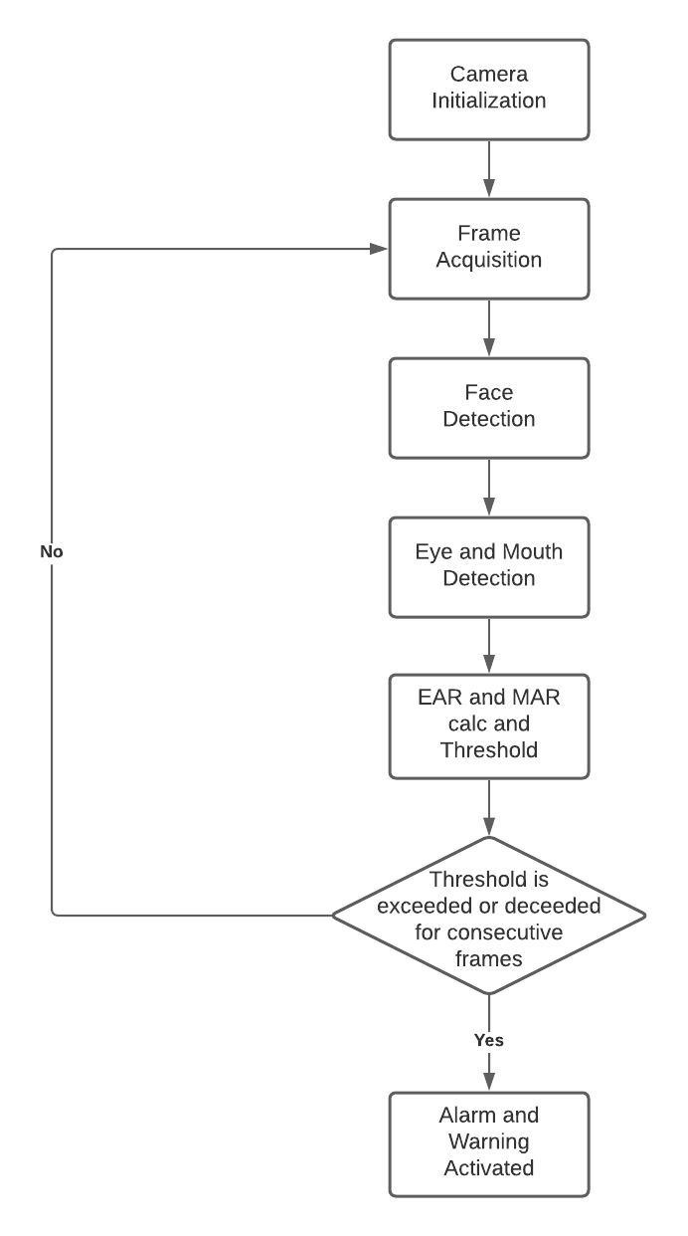
Proposed Method
Figure 2: Algorithm Flowchart

Slide 14
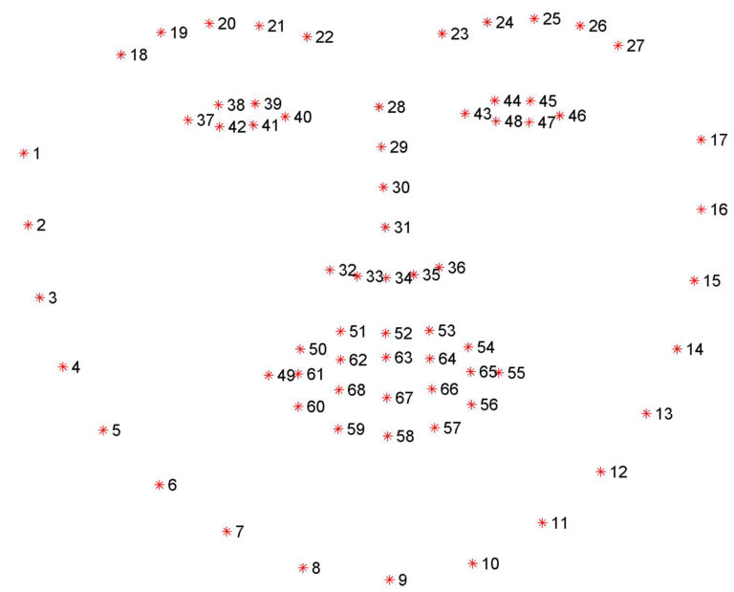
working
Pre-existing features for facial landmark detection is implemented to identify the state of drowsiness and fatigue.
The program uses a facial training set to understand where certain points exist on facial structures. The program uses priors to estimate the probable distance between key points.
For eye blinks we need to pay attention to points 37-46, the points that describe the eyes.
For yawns we need to pay attention to points 49-68, the points that describe the mouth.
Figure 3 : Visualization of the 68 facial
landmark coordinates
Notes:
The program then plots the same points on the region of interests in other images, if they exist.
The library outputs a 68 point plot on a given input image.
The camera is embedded to monitor and capture to extract frames one by one and generate alerts accordingly. Each frame will be analysed to study the patterns of facial features, using Haar Cascades Classifiers and determine the Eye Aspect Ratio (EAR) and Mouth Aspect Ratio (MAR) for each frame.

Slide 15
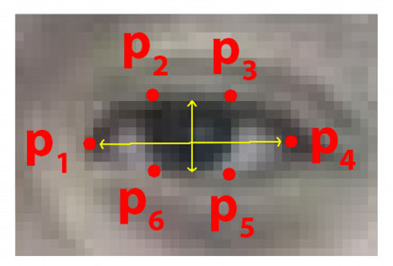
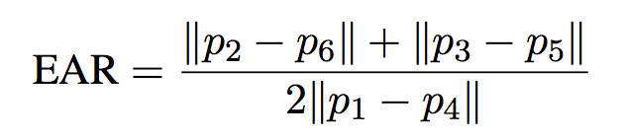
Eye Aspect ratio
The Eye Aspect Ratio is an estimate of the eye opening state.
The Eye Aspect Ratio is a constant value when the eye is open, but rapidly falls to 0 when the eye is closed.
A program can determine if a person’s eyes are closed if the Eye Aspect Ratio falls below a certain threshold.
Figure 4: Coordinates to calculate EAR
..........(1): Eye Aspect Ratio Equation
Notes:
EAR(Eye Aspect Ratio) is used to detect a blink which the ratio of vertical distance of the lower and upper eyelids to the horizontal length of an eye. During the eye blinks, the vertical distance of lower and upper eyelids decreases similarly in opened eye after a blink distance between the eyelids tend to increase. Therefore the EAR decreases and increases simultaneously, the blink count is incremented. The EAR count less than the threshold value reports suspicion in driver’s behaviour.
Frame differencing is another blink detection technique. Essentially, a program compare subsequent video frames to determine if there was any movement in a select eye region.

Slide 16
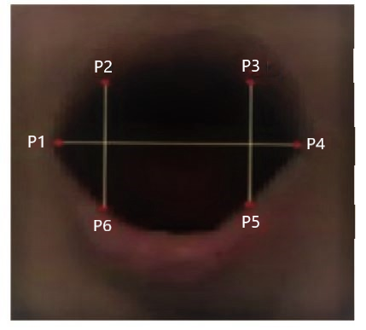
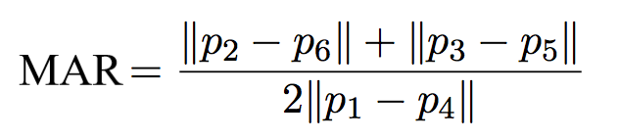
Mouth aspect ratio
The Mouth Aspect Ratio is an estimate of the mouth opening state.
Based on the above figure the Mouth Aspect Ratio can be defined by the below equation.
The mouth aspect ratio is a constant value when the mouth is closed and gradually rises to 1 when the mouth is opened.
Figure 5: Coordinates to calculate MAR
……….(2): Mouth Aspect Ratio Equation
Notes:
A program can determine if the person is yawning if the Mouth Aspect Ratio rises above a certain threshold.
Frame differencing is again used to determine the state of yawning.

Slide 17
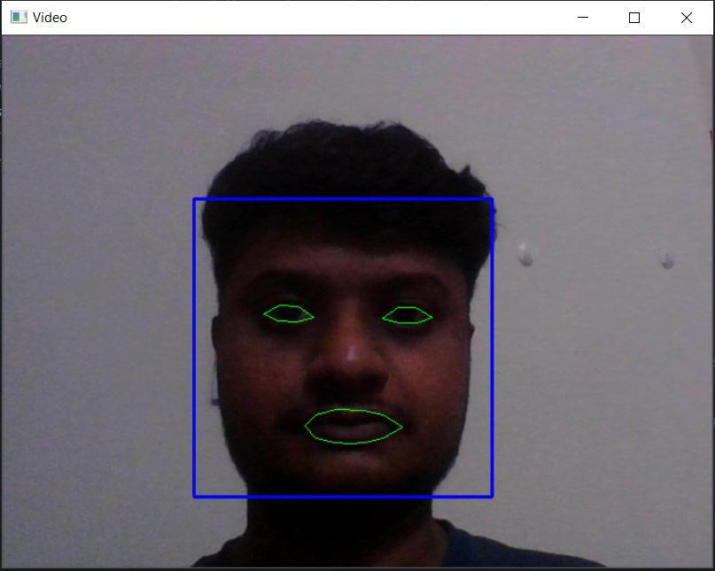
Output screen displays
Figure 6: Ideal Screen Output

Slide 18
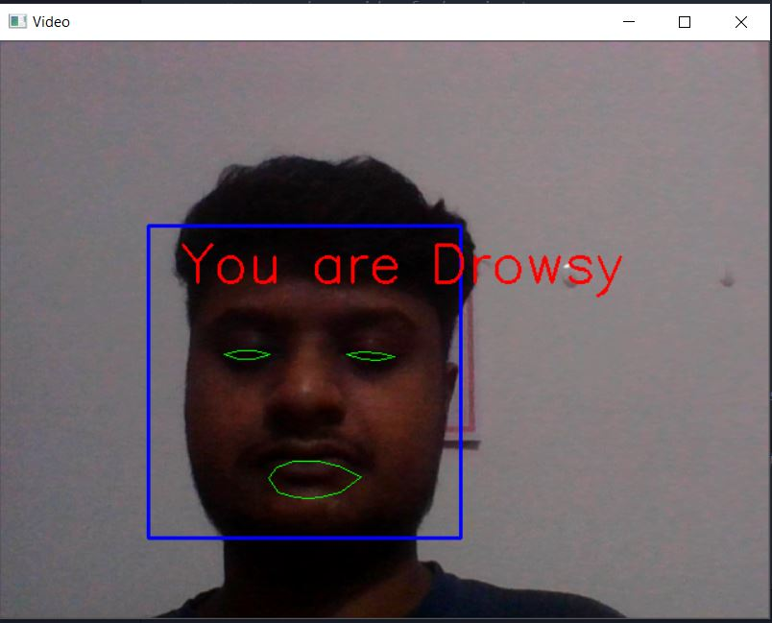
Figure 7: Drowsy State Detection

Slide 19
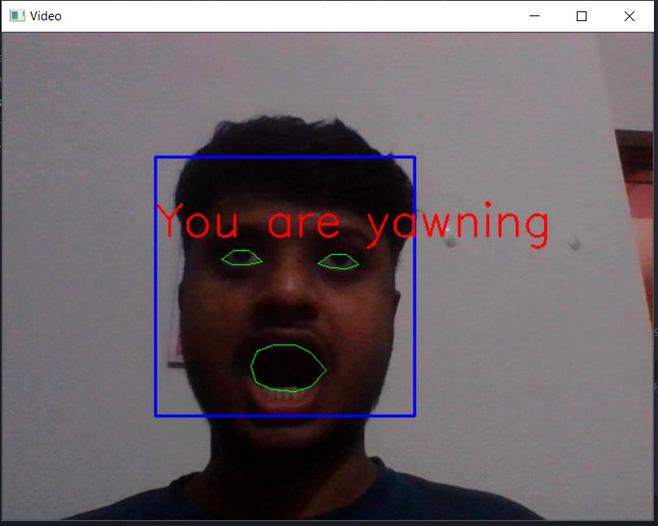
Figure 8: State of Yawning Detection

Slide 20
Sensors
MQ-9 sensor – Smoke and Gas Sensor.
DHT-11 sensor - Temperature sensor.
HC_SR04 - Ultrasonic sensor.

Slide 21
Steps where and how the sensors will be used.
Start
The Sensors are active and constantly receive related data and information
Action
If any sensor is triggered an alarm system is setup to warn the driver.
Result.
The driver can reset the system, for a false positive.
If not false positive the necessary action is taken.
Figure 9: Steps where and how sensors will be used

Slide 22
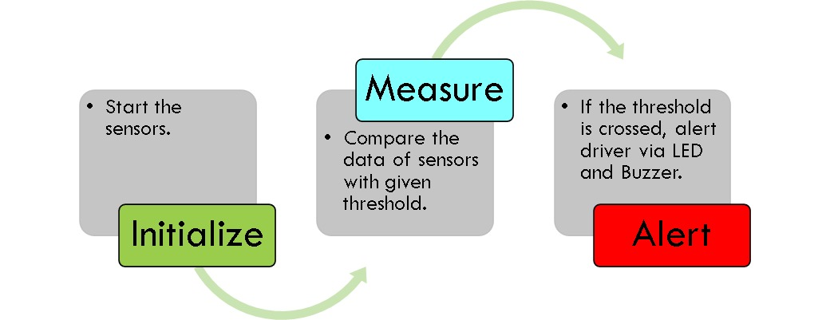
FLOWCHART FOR SENSOR FUNCTIONING
Figure 10 : Flowchart for sensor functioning

Slide 23
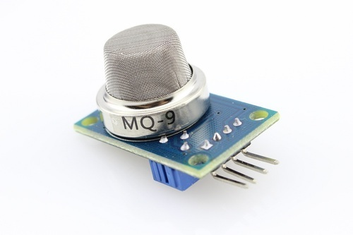
1. MQ-9 sensor – Smoke and Gas Sensor.
We use the MQ9 gas sensor here.
This will detect Carbon Monoxide, a highly harmful and deadly gas and alert its concentrations ranging from 10 to 10,000 ppm.
This sensor will also detect smoke, because the sensors conductivity is higher with more concentration of gas and smoke.
MQ-9 gas sensor has high sensitivity to Carbon Monoxide, Methane and LPG
Figure 11: MQ-9 Sensor

Slide 24
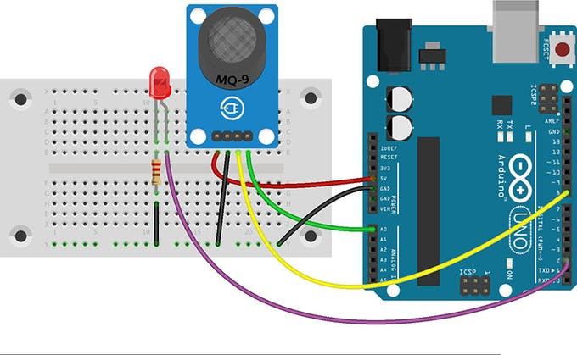
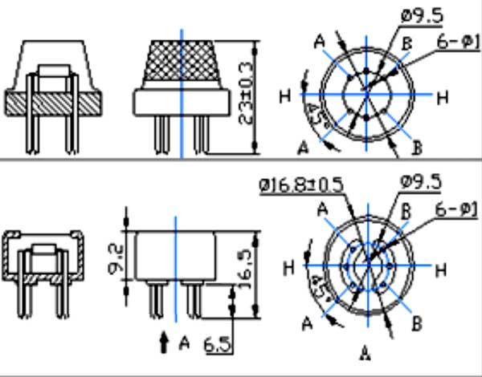
Figure 13: MQ-9 Sensor Dimensions
Figure 12: MQ-9 Sensor connection with Arduino UNO

Slide 25
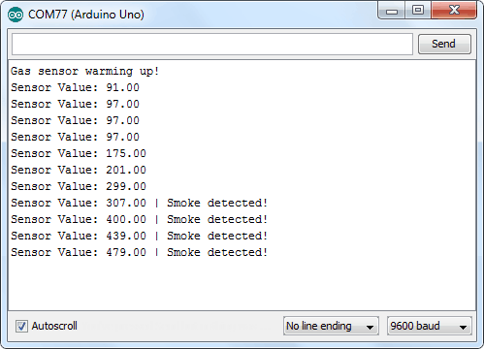
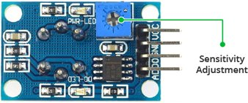
Figure 14: MQ-9 Sensor sensitivity
Adjustment.
Figure 15: MQ-9 Sensor Output.

Slide 26
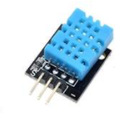
2. DHT-11 sensor - Temperature sensor.
It is an electronic device that measures the temperatures of its environment.
It converts the input data into electronic data to record and monitor.
It can even signal the temperature changes.
This can be used in automobiles, where it can detect very high temperatures and alert the driver, it can also detect the battery temperatures(In Electric Vehicles), It can also Alert when the temperature is exceeding the basic regulations.
Figure 16: DHT-11 Temperature Sensor

Slide 27
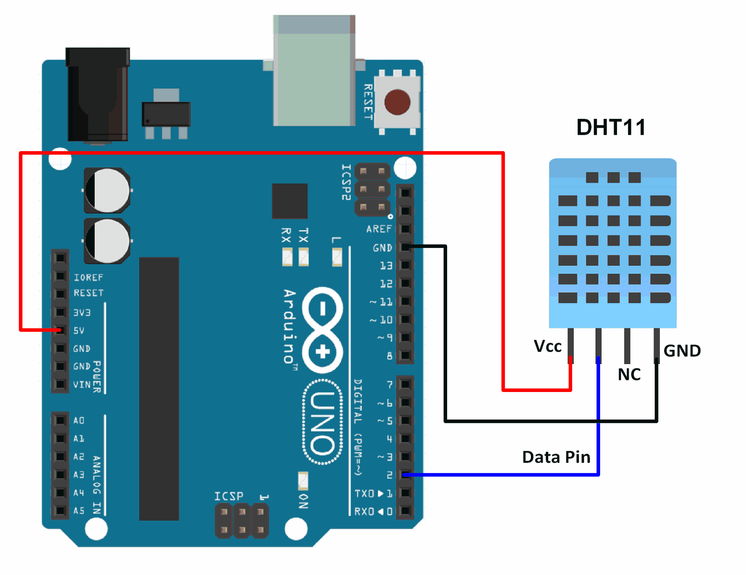
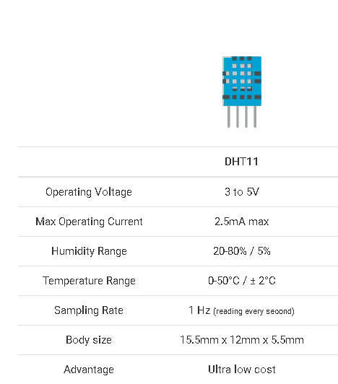
Figure 17: Connection with Arduino
Figure 18: DHT-11 Sensor Specifications.

Slide 28
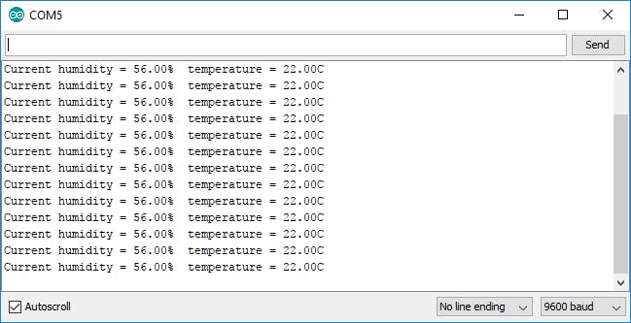
Figure 19: DHT-11 Output.

Slide 29
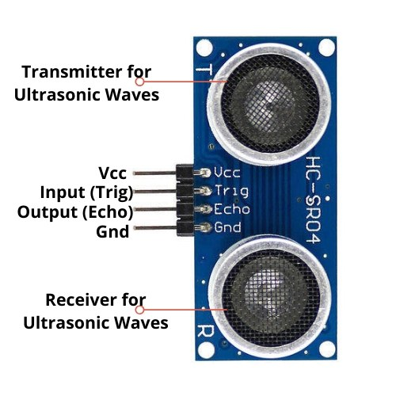
3. HC_SR04 - Ultrasonic sensor.
We can use two ultrasonic sensors here: HC-SR04 .
Both the sensors combined will alert if there is safe distance between vehicles.
As soon as the distance is unsafe, it will indicate the driver to slow down the vehicle and hence preventing an accident.
Figure 20: Ultra Sonic Sensor

Slide 30
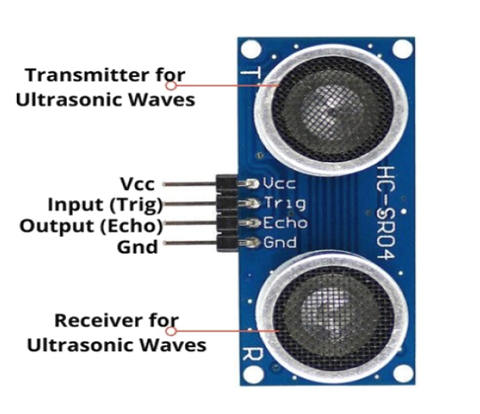
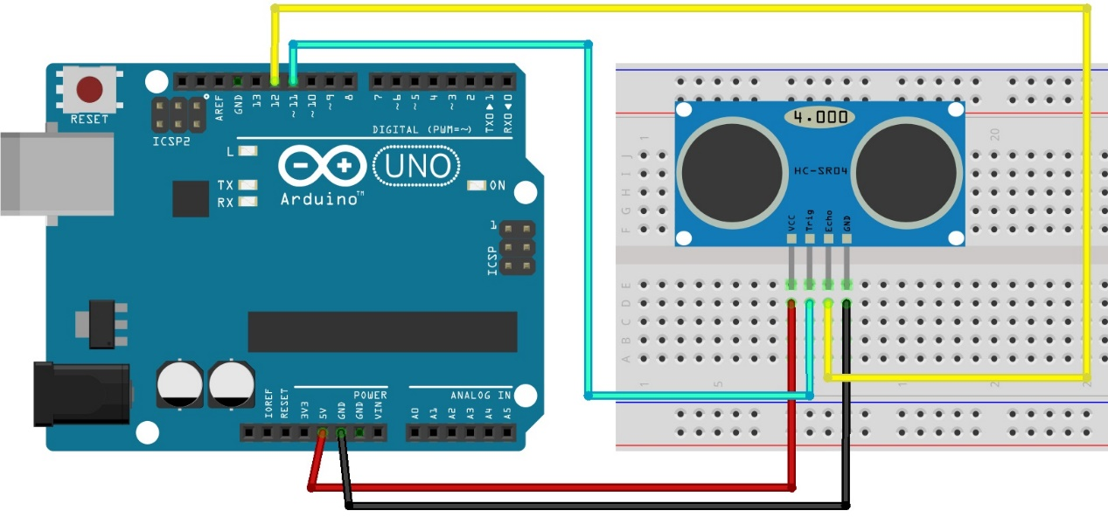
Figure 21: Connection with Arduino
Figure 22: HCSR-04 pins

Slide 31
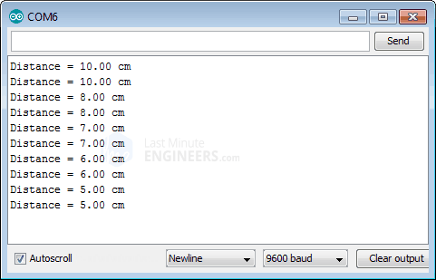
Figure 23: HCSR-04 Output.

Slide 32
Figure 24: Flowchart of Ultrasonic Sensor functioning

Slide 33
Figure 25:Sensor activity in case of accident

Slide 34
APPLICATIONS
Evaluate if the driver is drowsy.
Check if any harmful gases are present in the vehicle.
Check the temperature of the driver environment.
Prevent accidents due to drowsiness in harsh weather.

Slide 35
Advantages
Real-Time monitoring from the system.
The sensors are cost efficient.
They don’t take up much space.
Easily replaceable.
High levels of safety regarding the pollution abatement due to over usage of the vehicle is ensured.
Prevent accidents and save lives.

Slide 36
Disadvantages
The data might not be a 100% accurate.
False System Failure due to network issues.
False interpretation due to unusual behavior by the driver.
It may malfunction due to external factors.
It is difficult to establish a proper energy interface for all the sensors.
Accuracy in controlling the sensors depends on the signal strength.
The sensor may occasionally fail and hence faulty signals could be sent to the microcontroller board.

Slide 37
Future Scope
A much advanced and efficient system can be designed with additional features.
The Drowsiness Detection System can be interfaced into a Driver Performance System which would track multiple parameters of the vehicle’s movement and the driving style.

Slide 38
Conclusion
We have developed a Real-Time Driver Drowsiness Detection and Alarm system which is implemented to detect the drowsiness and fatigue of a driver based on the live images captured in order to minimize the rate of road accidents.

Slide 39
RESULT
The below link shows a brief demonstration video of the project.
Demo Video

Slide 40
References
Ashlesha Singh, “Driver Drowsiness Alert System with Effective Feature Extraction”, IJREST, 2018
Swaleh Owais, “Eye Blink Detection Algorithms”, BlinkToText (hackday.io), 2017
A Rosebrock. (2017, Apr. 3). Facial landmarks with dlib, OpenCV, and Python [Online].
T. Soukupova and J. Cech. (2016, Feb. 3) Real-Time Eye Blink Detection using Facial Landmarks. Center for Machine Perception, Department of Cybernetics Faculty of Electrical Engineering, Czech Technical University in Prague. Prague, Czech Republic. [Electronic].
V. Kazemi and J. Sullivan. (2014) One Millisecond Face Alignment with an Ensemble of Regression Trees. Royal Institute of Technology Computer Vision and Active Perception Lab. Stockholm, Sweden. [Electronic].
K. Toennies, F. Behrens, M. Aurnhammer. (2002, Dec. 10). Feasibility of Hough-Transform-based Iris Localisation for Real-Time-Application. Dept. of Computer Science, Otto-von-Guericke Universität. Magdeburg, Germany. [Electronic].

Slide 41
THANK YOU

